Slide 1
Nuclear Medicine
Radiopharmaceutical chemistry

Slide 2
MRI
Magnetic Resonance Image :
Use Magnetic Field

Slide 3
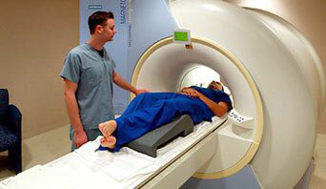

Slide 4
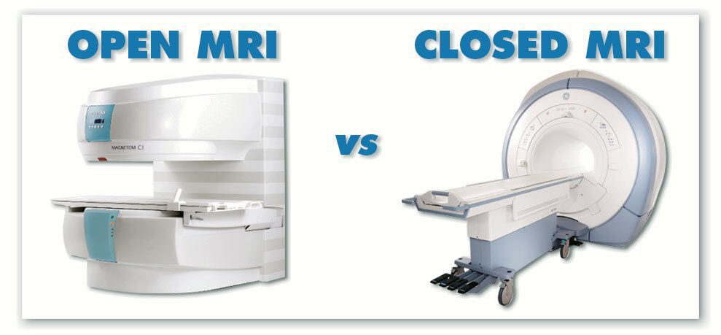

Slide 5
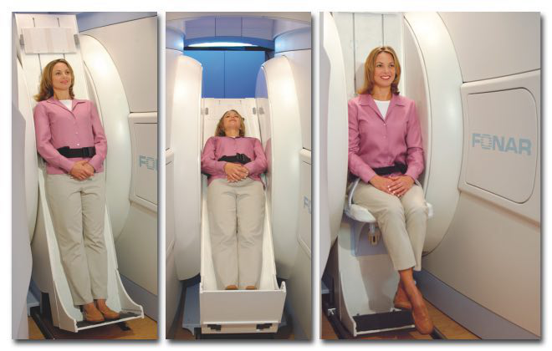

Slide 6
Radiopharmaceutical Preparations
Sodiumchromate Cr-51 inj.Na2CrO4(Rachromate)
-diagnostically to determine RBC mass ,volume,&Survival time also scanning the spleen.
Radio-Chromated Serum Albumin Cr-51.
-determinde plasma volume.

Slide 7
Cyanocoblamine Co-57 ,Co-50,Co-60
-diagnostic procedure for pernicious anemia.
-interstitial implantion.

Slide 8
Ferrous citrate and Ferric chloride Fe-59
Diagnostic procedure of iron metabolism and RBC formation

Slide 9
Gold(Aurcoloid-198)
-Solution is categorized as both diagnostic preparation for scintillation scanning of the liver,and a therapeutic preparation in the treatment of disorders secondary to neoplastic diseases.

Slide 10
Iodides I-123, I-125 ,I-131
Sodium iodide
Diagnostic and therapeutic purpose.
Uptake or general thyroid scanning
Scanning for metastatic thyroid cancer.
Therapeutic in the hyperthyroidism cancer.

Slide 11
Iodinated Serum Albumin iv
Determination blood and plasma volume and determination cardiuc output.

Slide 12
Sodium Iodohippurate inj.
-Diagnostic agent for determine renal function.
Sodium Rose bengal (Robengatope)
-Liver function ,scan size and location
-blood and bile clearance
Mercury -197 and 203
-Chromerodrin Hg inj.
-scanning both kideny and brain

Slide 13
Sodium phosphate P-32
-Used for both diagnosis and treatment of various neoplastic disease .
Technetium 99m

Slide 14
The end
Thank you

